Slide 1
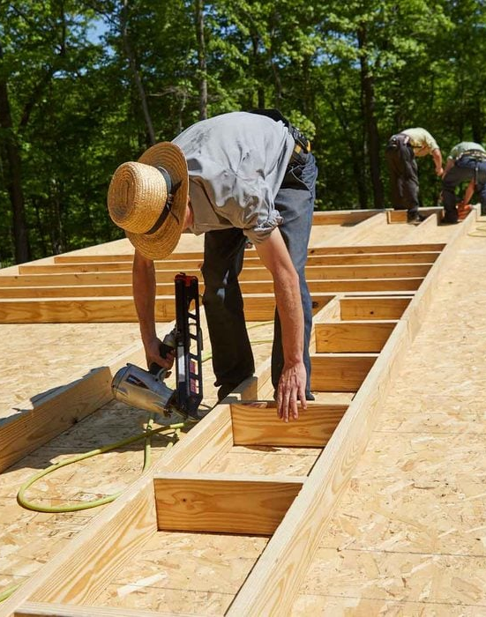
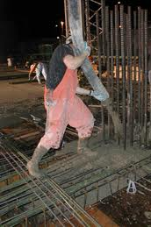
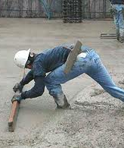
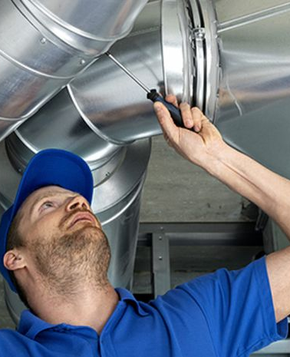

Creating an Ergonomic Worksite
Tracey McLenon

Slide 2
Objective
Educate
Educate participants about ergonomics in the construction industry.
Identify
Identify common hazards and opportunities for improvement.
Provide
Provide practical tips for reducing workplace injuries.
Notes:
According to the National Institute for Occupational Safety & Health (NIOSH), health problems associated with ergonomics compose the most prevalent lost-time injuries and illnesses in almost every industry.
The back is the most commonly injured body part. Most back problems are symptoms of low back injuries caused by heavy lifting or frequent bending. Construction workers bend over an average of 20,000 times every year!

Slide 3
What is Ergonomics?
Fitting the Job
to the Person
(using your brain,
not your back!)
The art and science of reducing physical and psychological problems that might arise from the interaction between people, equipment, and the environment.

Slide 4
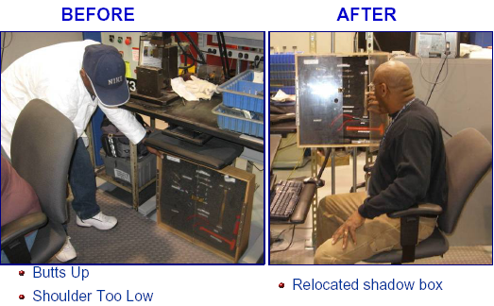
What is Ergonomics?
A relentless pursuit and continuous improvement effort to design the workplace for what people do well, and design against what people don’t do well.

Slide 5
Sprains
An injury which occurs to ligaments caused by sudden overstretching.
Results in localized pain, swelling, and loss of function in a joint, usually hours after the initial injury.
Common in the knee, finger, wrist, and ankle.
Treatment includes rest, ice, compression, and elevation (RICE).
Notes:
Rest - no weight bearing for the first 24 hours after the injury (Possibly longer, depending upon severity)
Ice - apply ice packs using a towel over a plastic bag to the area that is painful. Be careful to avoid frostbite. Ice should be intermittently applied for the first 24 hours.
Compression - an ACE bandage or other soft elastic material should be applied to the ankle to help prevent the accumulation of edema.
Elevation - elevating the ankle helps in removing edema. By having the foot higher than the hip (or heart), gravity is used to pull edema out of the ankle.
In the initial 24 hours, it is very important to avoid things which might increase swelling:
hot showers
heat rubs
hot packs
drinking alcohol
anti-coagulants drugs may prolong the clotting time of blood and may cause more bleeding into the ankle.
Most common sprain is ankle, mostly due to sports related injuries.

Slide 6
Strains
An injury to the muscle in which the muscle fibers tear as a result of overstretching.
Results in stiffness, bruising, inflammation, and localized pain.
Common in the low back or shoulder.
Treatment includes rest, ice, compression, and elevation (RICE).
Notes:
Larger muscle groups = more significant injury, harder to diagnose, long recovery period.

Slide 7
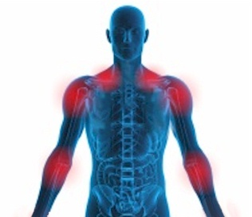
Repetitive Strain Injury
Any of a loose group of conditions resulting from overuse of a tool, eg. computer, guitar, knife, etc. or other activity that requires repeated movements.
It is a syndrome that affects muscles, tendons and nerves in the hands, arms and upper back.
Notes:
Carpal Tunnel.
Blackberry thumb from text messaging.
Playing video games!

Slide 8

By the Numbers
Construction industry employers reported a total of 74,520 non-fatal work-related injures requiring days away in 2020 (BLS).
Contact with object, equipment: 22,470
Falls, slips, trips: 21,510
Overexertion and bodily reaction: 18,980
  6,310 from overexertion during lifting or lowering
  520 from repetitive motion

Slide 9
By the Dollars
In 2000, OSHA estimated that $1 of every $3 spent on workers’ compensation stems from ergonomic issues and that the direct costs attributable to MSDs were $15 to $20 billion a year, with total annual costs upwards of $54 billion.

Slide 10
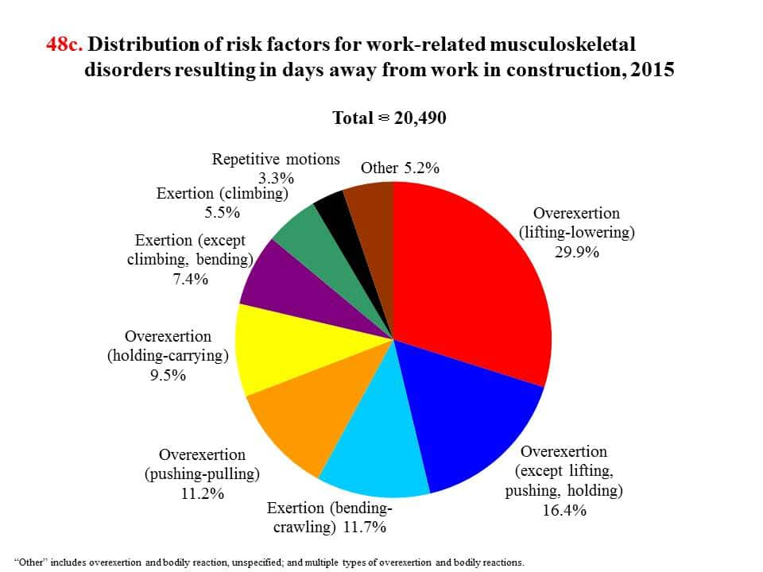
Source: CPWR

Slide 11
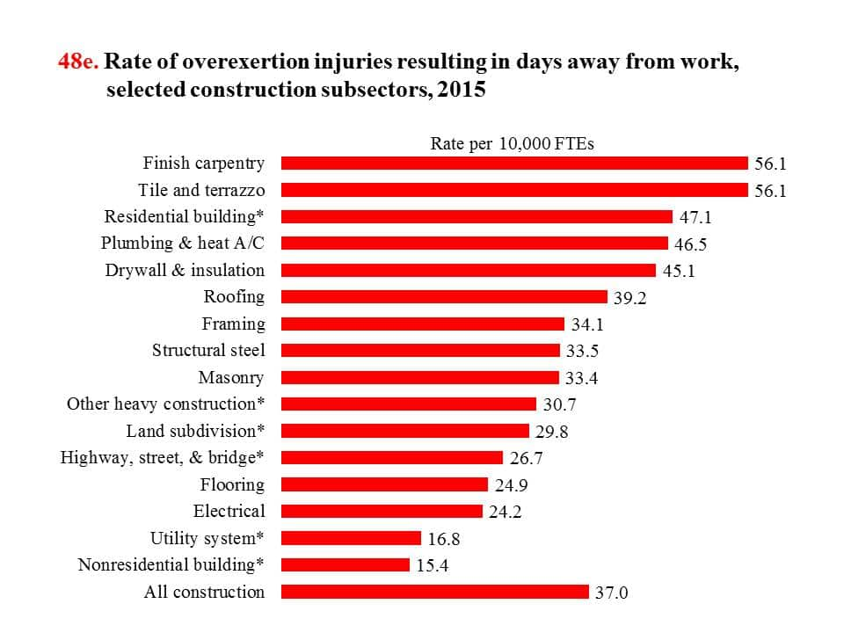
Source: CPWR

Slide 12
Applicable Standards
Construction Industry
General Industry
OSHA will use the General Duty Clause to cite employers for ergonomic hazards. Under the OSH Act's General Duty Clause, employers must keep their workplaces free from recognized serious hazards, including ergonomic hazards. This requirement exists whether or not there are voluntary guidelines.

Slide 13
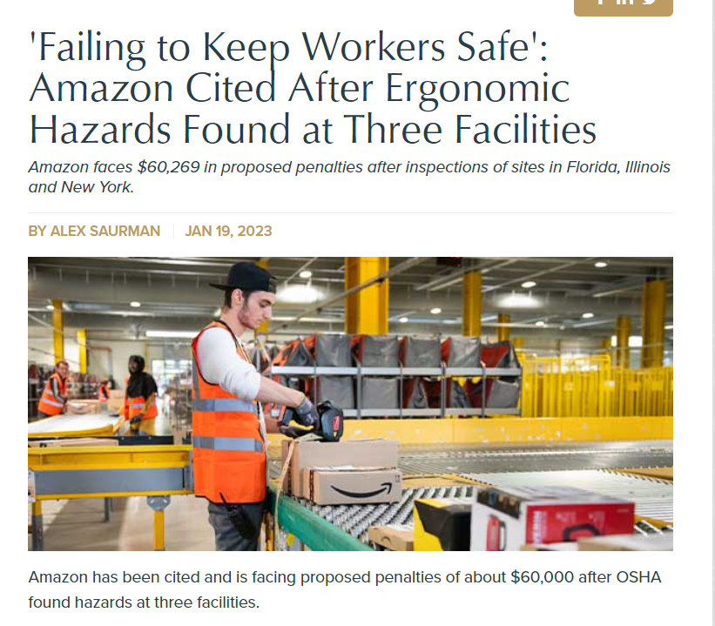
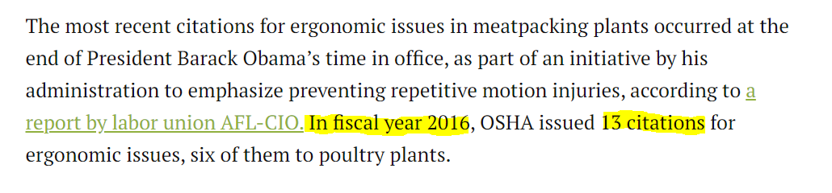
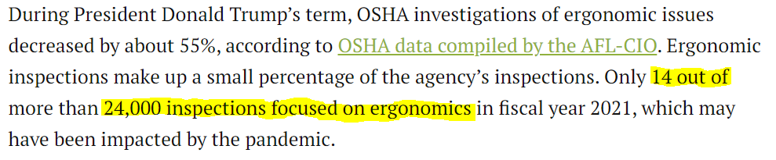
Enforcement

Slide 14
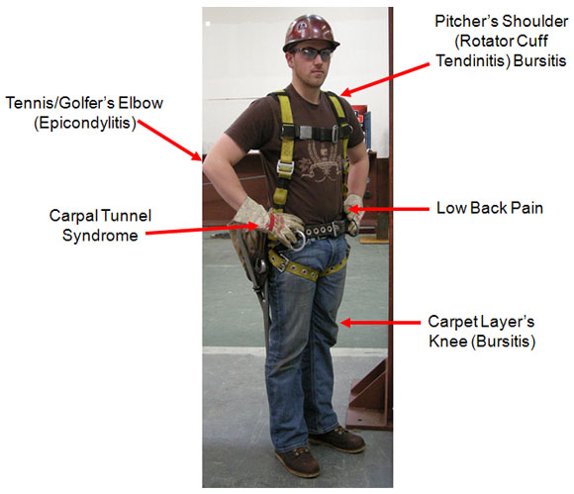

Slide 15
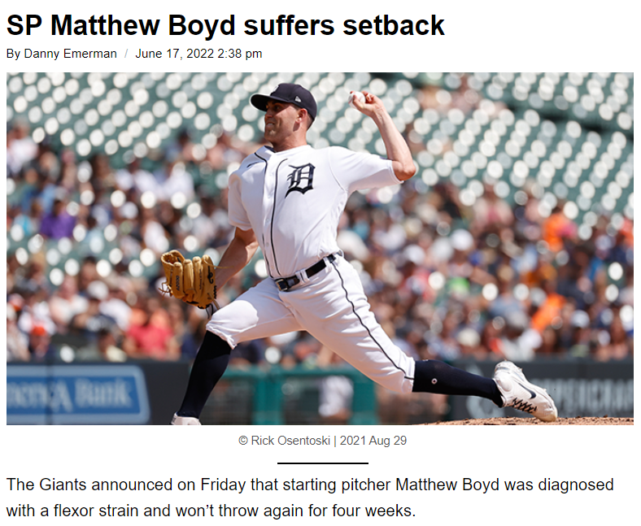
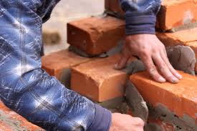
Repetitive Motion
  Stress on muscles and tendons
  Contributing factors
    Duration and speed of repetitious movement
    Number of muscles
    involved
    Required force
Doing it the same way, over and over
Notes:
Making the same movement over and over eventually tires muscles. If you keep using those tense, tired muscles, your risk of injury increases. A move is especially risky if you combine repetition with poor position or excessive force.

Slide 16
Risk Factors
Repetitive Motion
  Same motion, every few seconds, 2 consecutive hrs
Forceful Exertions
  Lifting
    75 lbs once, 55 lbs 10 times, 25 lbs in awkward position 25 times
Awkward Posture
  Below the knees, above the shoulders, bent wrist
Contact Stress
  Pounding, kneeling, gripping
Vibration
Notes:
This is what you’re doing to create all of those aches and pains.

Slide 17
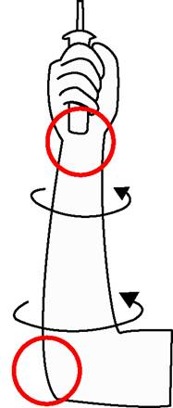
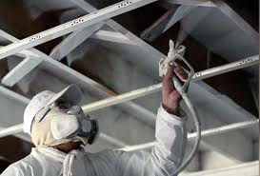
Forceful Exertions
  Inflammation of tendons, nerves, joints
  Contributing factors
    Type of grip
    Weight of object
    Body posture
    Type and duration of the task
  Repeatedly turning a screwdriver while pushing at the same time
Image Credit: OSHA
Notes:
Forceful actions that strain muscles and tendons increase your risk of injury.

Slide 18
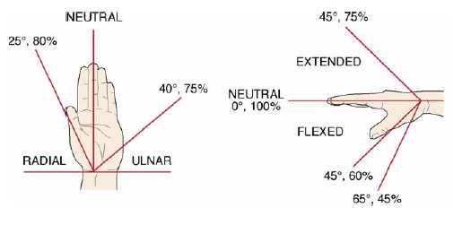
Strength Dependent on Posture
Notes:
Do “OK” exercise

Slide 19
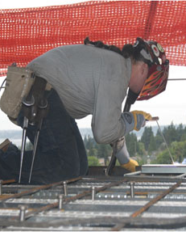
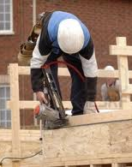
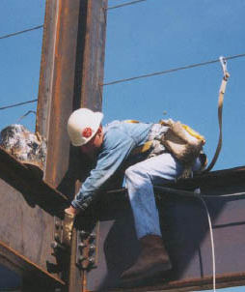
  Stress on muscles and tendons
  Lifting while twisting, reaching, or turning
Awkward Postures
Notes:
Contributing factors - Reaching overhead, Force the body must maintain to hold the position, Holding fixed positions (static loading)

Slide 20
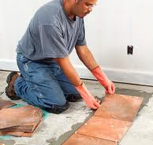
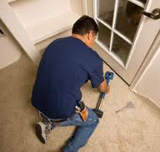
  Pressing against or grabbing a hard object puts pressure on nerves, tendons, and blood vessels
  Contributing factors
    Repetition
    Duration of contact
    Grip strength required
  Resting wrists on the keyboard while typing
Contact Stress

Slide 21
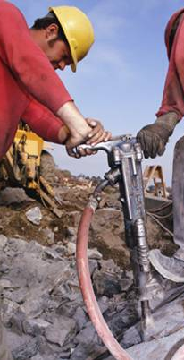
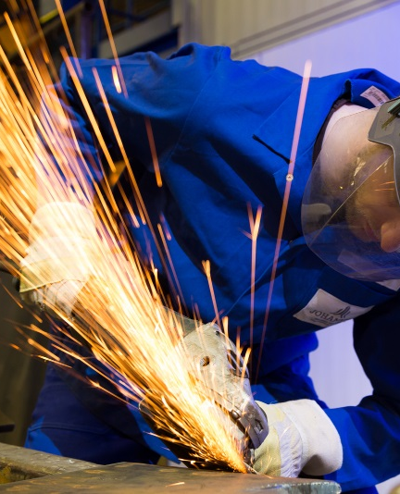
Vibration
Affects tendons, muscles, joints, nerves
Contributing factors
  Prolonged grip
  Restricts blood supply to hands and fingers
  Tools without vibration dampening device
  Poor power tool maintenance
Prolonged use of a grinder
Notes:
Wrong cutting blades contributes, too.

Slide 22
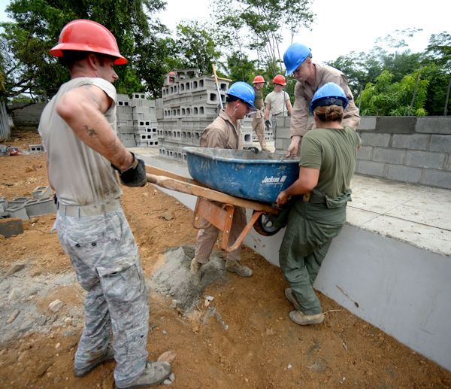
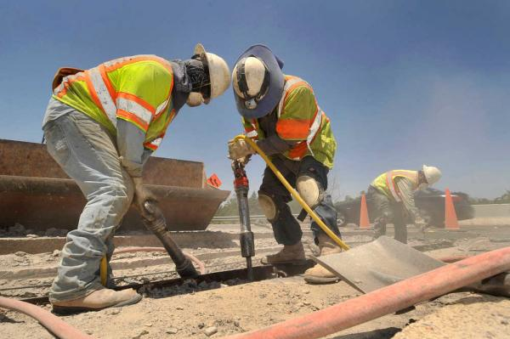
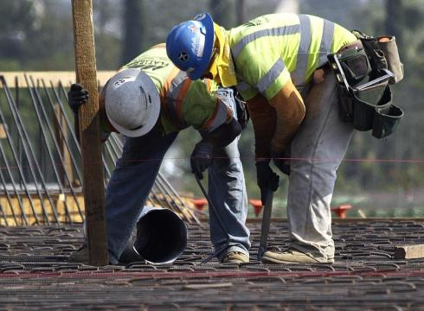
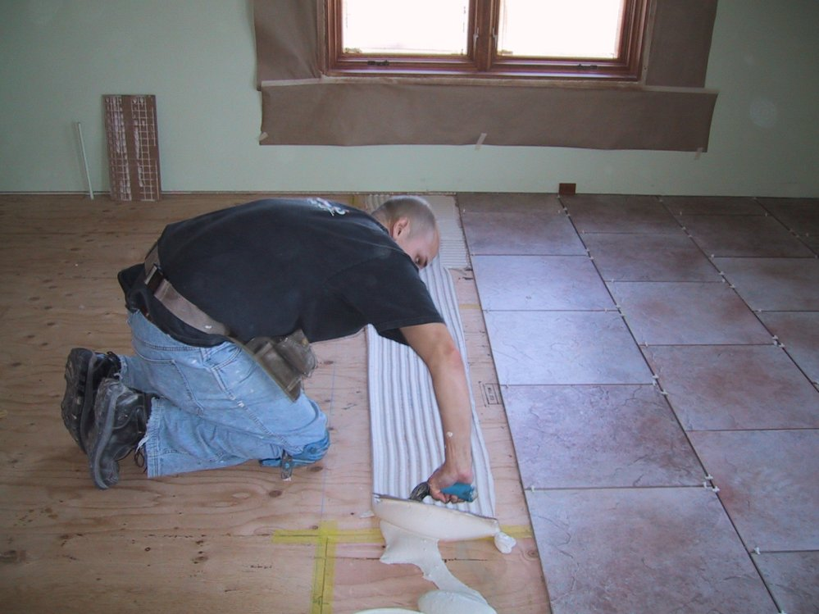

Slide 23
When can you retire?
Construction workers who were above 50 years old reported*:
  low back pain (31.2 percent)
  joint problems (31.9 percent)
  hearing loss (34.4 percent)
  vision problems (despite corrective glasses or lens, 15.3 percent)
  hypertension (46.4 percent)
  diabetes (8 percent for those aged 55 and older)
The rate of work-related deaths steadily increases with age, resulting in the greatest risk for older workers 55 years and older.
The average age for retirement from construction is 61.
*2009 report from CPWR

Slide 24
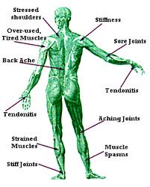
Where does your job hurt you?

Slide 25

How can you extend your shelf life?

Slide 26
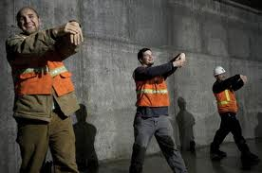
The Industrial Athlete
Beginning in 2003, UPS NorCal implemented a full ergonomic program. By 2005, reduced comp costs by 60%
Zurich Insurance reports a 60% reduction in frequency of sprain/strains and a 30% reduction in severity of injury amongst clients mandating daily stretching
Notes:
48th out of 50 locations. Reduced injury claims by 84%. Implemented new seats in vans, handles to worker height, weight training/fitness centers in location

Slide 27
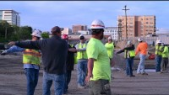

Slide 28
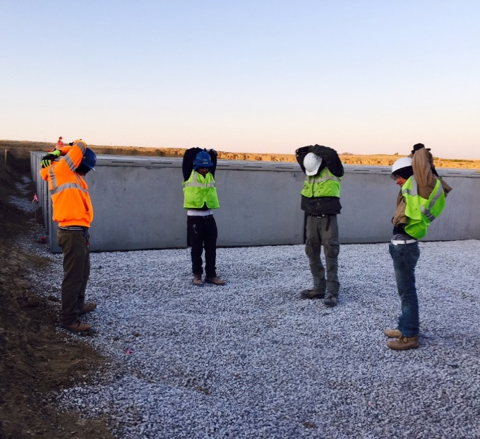
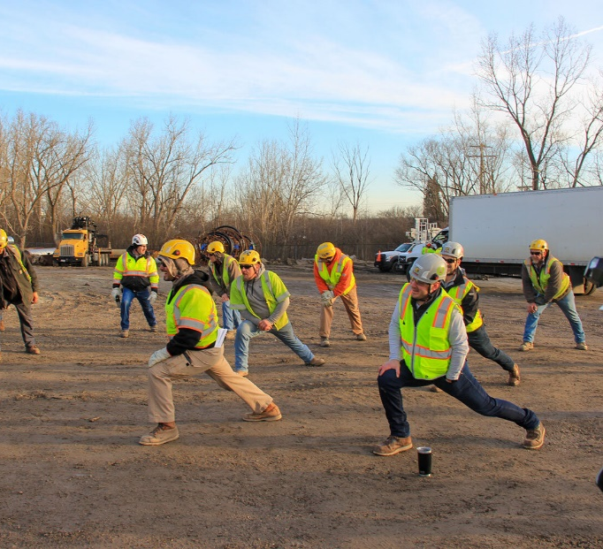
Stretching Basics
Benefits of stretching:
  Increases flexibility/elasticity of muscles
  Increases circulation to warm the muscles, improving mental alertness, reducing fatigue
  Decreases muscle tension and stress
When to Stretch:
  Prior to starting your day
  During short breaks (at least once per hour)
  After breaks or lunch to prevent fatigue
  If tension or stress is apparent

Slide 29
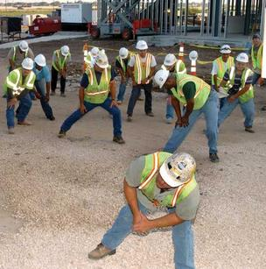
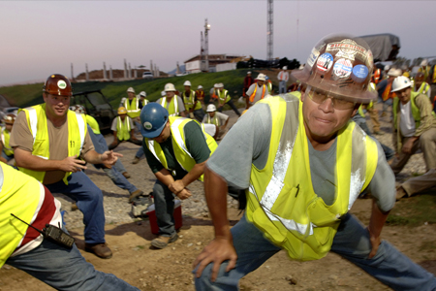
Stretching Basics
Proper stretching techniques:
  Relax and breathe normally. Do not hold your breath.
  Hold each stretch for a count of 15, or as long as comfort is maintained.
  Use gentle, controlled motions. Do not bounce!
  Keep the knees slightly bent for better balance.
  Stretch until a mild tension is felt, then relax.
  Stretch by how you feel and not by how far you can go.

Slide 30
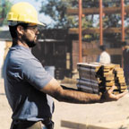
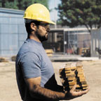
The Practical Approach
Reaching and lifting, or carrying a 10 pound object that is 25 inches from your spine is equal to 250 pounds of force on your lower back.
Reaching and lifting, or carrying a 10 pound object that is 10 inches from your spine is equal to 100 pounds of force on your lower back.
Notes:
Choose someone to demonstrate with empty box. Have a variety of box shapes?

Slide 31
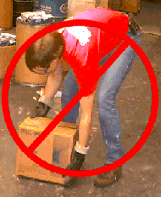
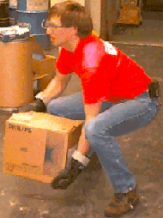
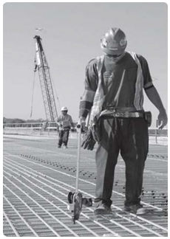
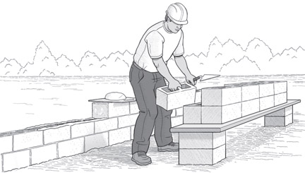
The Practical Approach

Slide 32
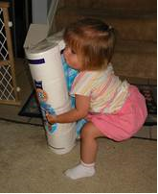
Textbook Lift

Slide 33
Creating Ergonomic Worksite
Avoid unnecessary hazard exposure
  Stage tools & material as near to work area as possible
  Reduce number of trips up and down the ladder by using a tool pouch or belt
  Reduce number of trips to and from van by using a toolbag, dolly, or cart to bring everything in at once
  Take breaks or rotate workers when needed
Notes:
Clear paths and excellent house keeping are critical components of an ergonomic worksite. If you’re dodging extension cords or piles of material, you are in danger of twisting your ankle or knee, not to mention the tripping hazard.

Slide 34
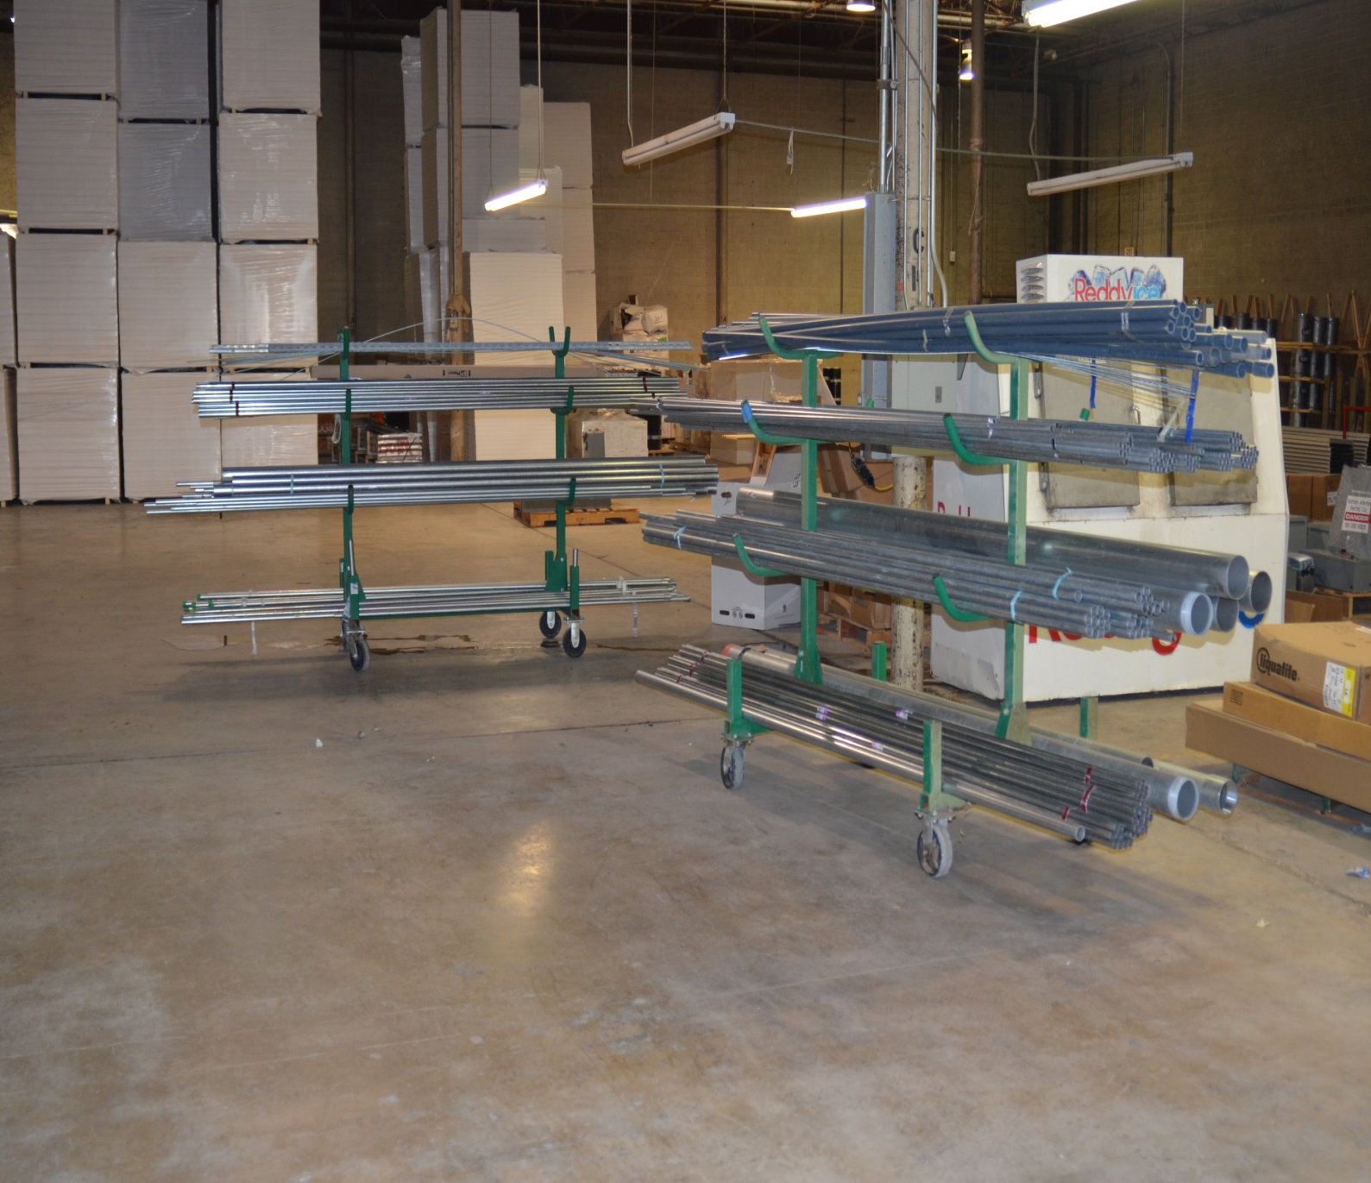

Slide 35
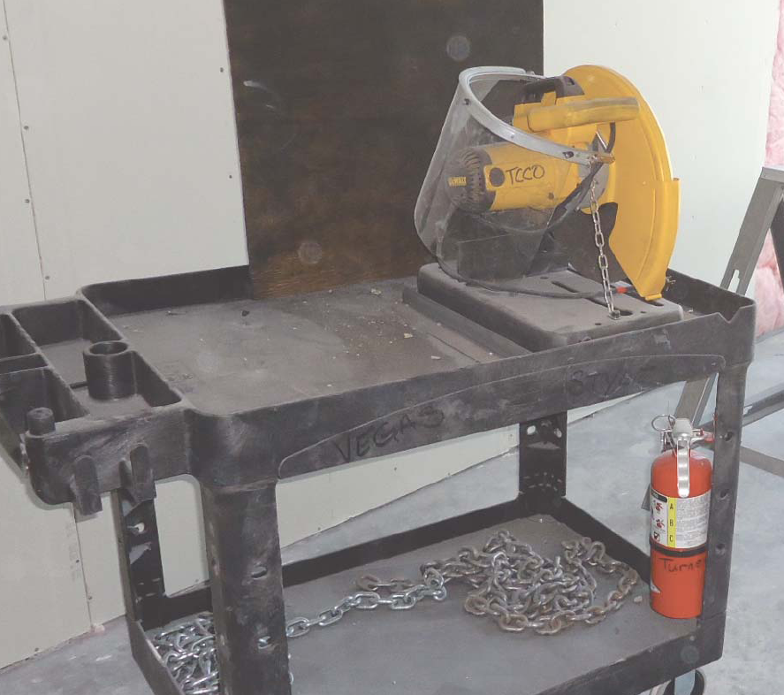

Slide 36
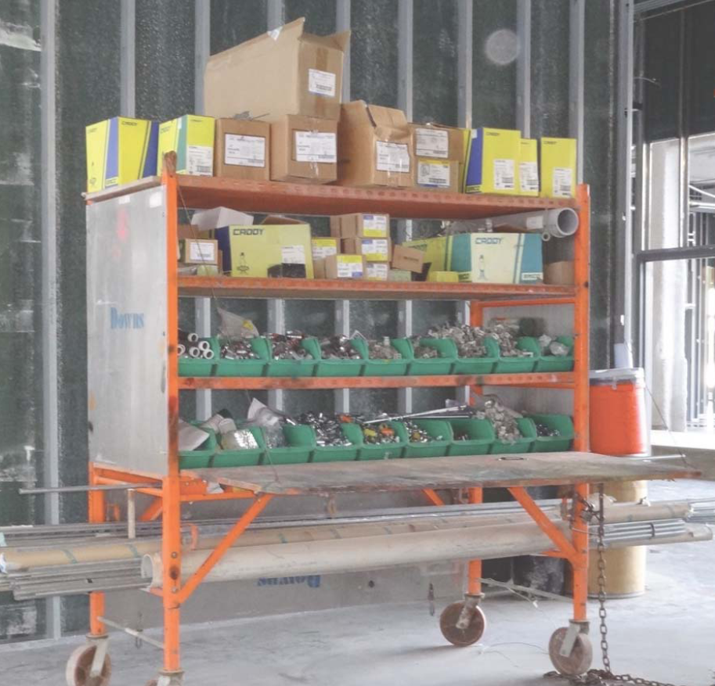

Slide 37
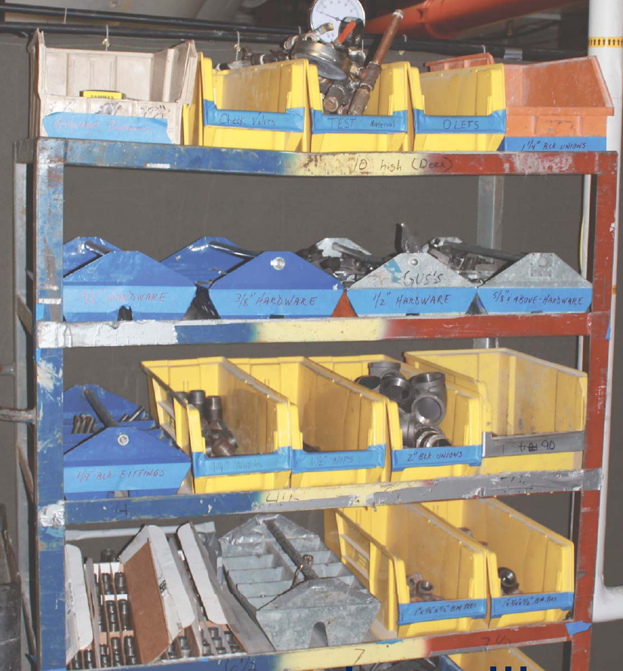

Slide 38
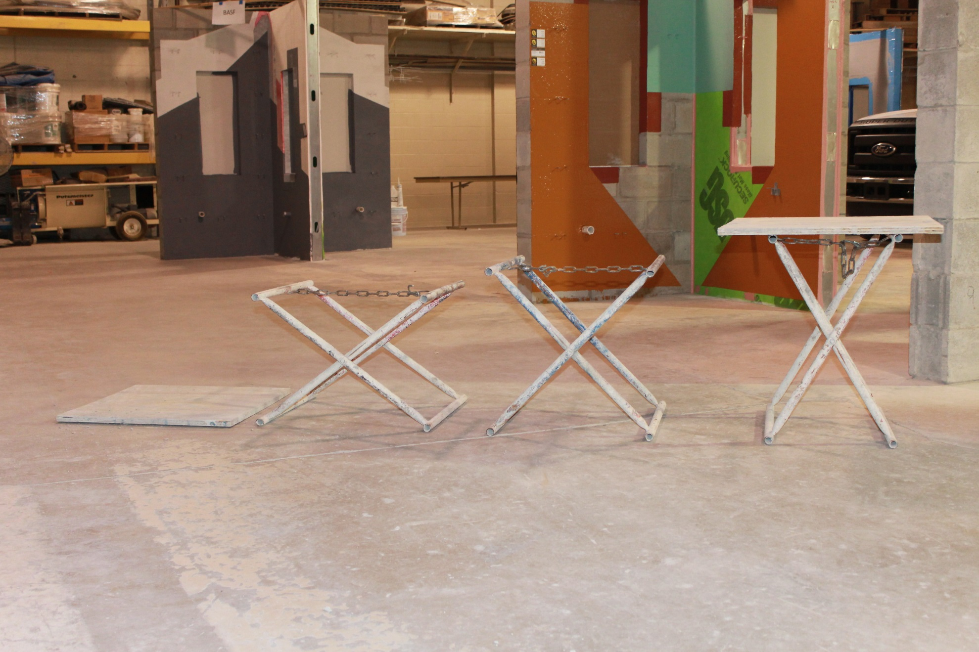

Slide 39
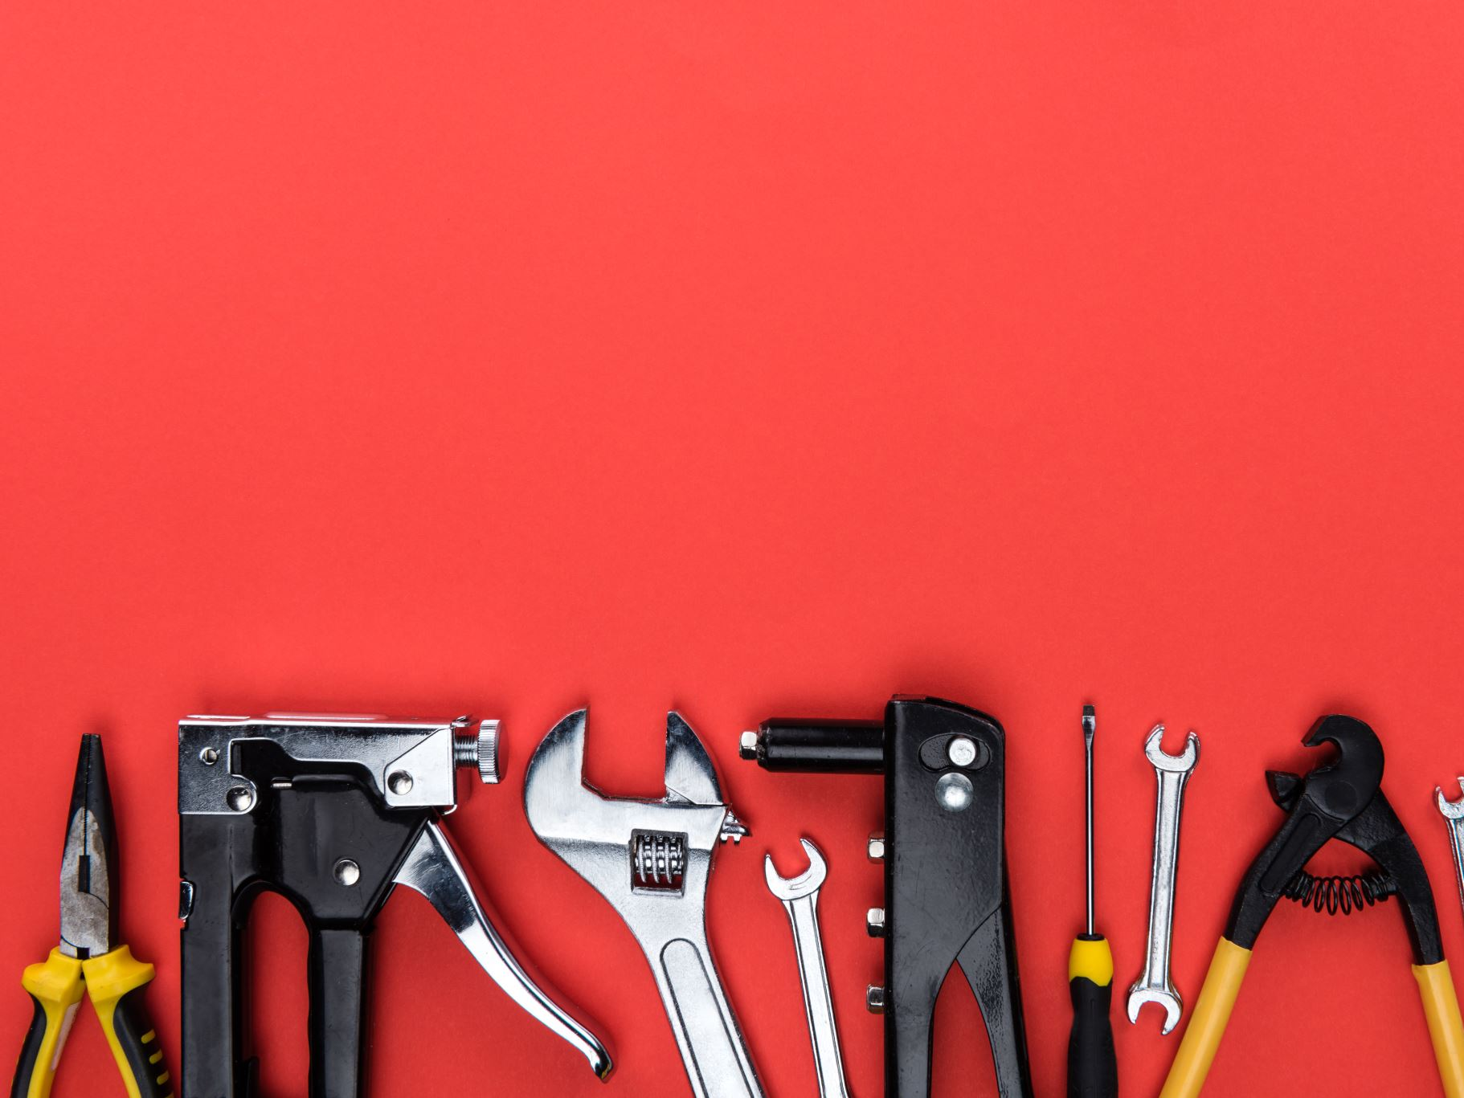
Creating Ergonomic Worksite
Modify tools when possible
  Wrap foam insulation or duct tape around bucket handle or hammer to increase size and your grip strength
  Use appropriate cutting blades to reduce vibration and kick back
Notes:
Ever think of that?

Slide 40
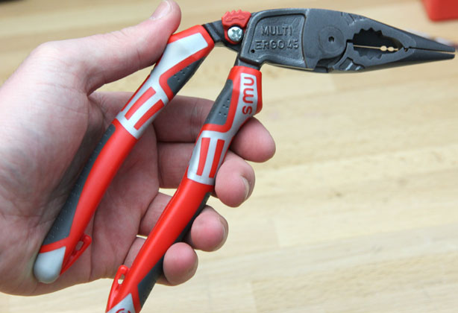
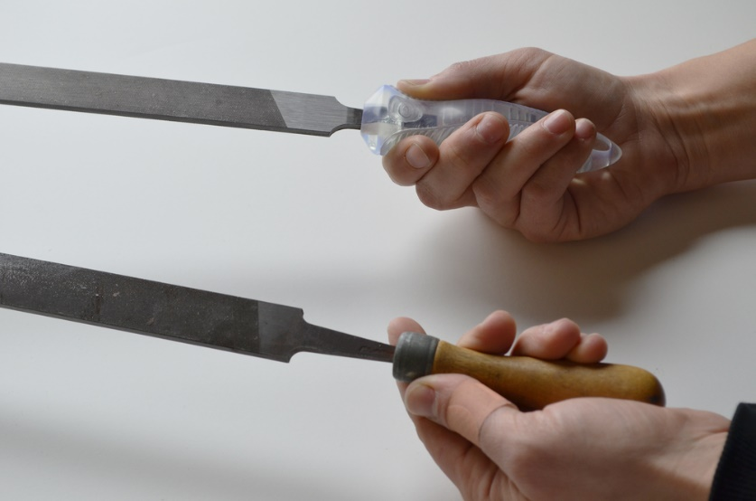





Ergonomic Tools
Notes:
Ladders with wheels, 2-wheeled wheel barrows, bent shove handles, wider grips on the saw, angled pliers and keyboard.

Slide 41


The Practical Approach
Select the correct tool handle orientation based upon work surface height/orientation (when possible)
Pistol grip
In-line grip
Primary Use | Surface Orientation | Select this tool type
Above shoulder height | vertical surface | in-line grip
 | horizontal surface | pistol grip
Between elbow and shoulder height | vertical surface | pistol grip
 | horizontal surface | in-line grip
Below elbow height | vertical surface | in-line grip
 | horizontal surface | pistol grip

Slide 42


The Practical Approach
BETTER
BETTER
Using a short-handled tool puts direct pressure on the palm of your hand. Over time you may feel numbness and weakness in your hand when using a short-handled tool. |  | Using a tool that has a longer handle spreads the pressure over a larger area of your hand.

Slide 43




Slide 44

Necessity…
Designed/Invented by Jim Byrne, Bricklayer Local 3
The McGovern Lever uses an adjust-able see-saw attached to scaffolding to serve as a lift for a drill fastened to a post.
You press down with your foot, the see-saw lifts the post, thus applying upward pressure for the drill to do its job over-head.

Slide 45
Creating an Ergonomic Worksite
Use personal protective equipment
  Kneeling pads or knee pads
  Anti-vibration or rubber coated gloves
  Sturdy work shoes w/non slip soles
  Make sure gloves fit properly
Notes:
Bulky heat resistant gloves reduce grip strength by as much as 40%

Slide 46


Creating an Ergonomic Worksite

Slide 47
Lessons Learned
Injuries attributed to poor ergonomics significantly impact earning potential
Minor adjustments result in long term improvement

Slide 48
Long Term Benefits
Less likely to experience injury
Extend ability to perform strenuous tasks
Improve efficiency

Slide 49

Questions

Slide 50

Additional Resources

Slide 51
Contact Information
Tracey McLeon
tmclenon@BuildwithCAM.com
248-972-1113

